Slide 1

Varendra University
Dept. of Computer Science & Engineering (CSE)
The String Instructions (Chapter-11)
Course Title: Microprocessor and Assembly Language
Course No: CSE 3205
Prepared By:
Md. Adnan Sami
Lecturer, Dept. of CSE, VU

Slide 2
Outline
  General Form of the String Instructions.
  Moving a String.
  MOVSB.
  MOVSW.
  Example 11.2.
  STOSB.
  LODSB.
  SCASB.
  CMPSB.

Slide 3
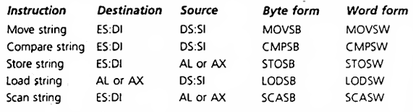
General Form of the String Instructions

Slide 4
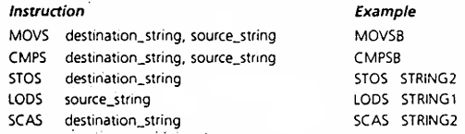
General Form of the String Instructions

Slide 5
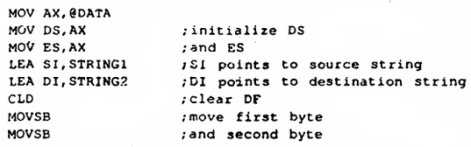
Moving a String
  The MOVSB instruction,

Slide 6
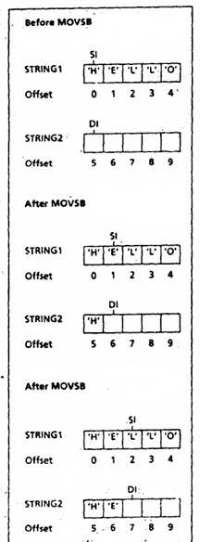
MOVSB
Figure 11.1

Slide 7

MOVSW
MOVSW moves a word from the source string to the destination string.

Slide 8
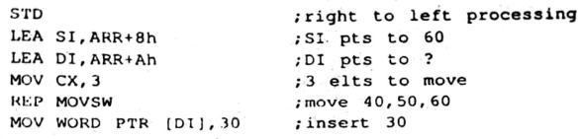
Example 11.2 (*)
  For the following array,
  ARR DW 10, 20, 40, 50, 60, ?
  Write instructions to insert 30 between 20 and 40. (Assume DS and ES have been initialized to the data segment.)
  Solution:

Slide 9


STOSB

Slide 10
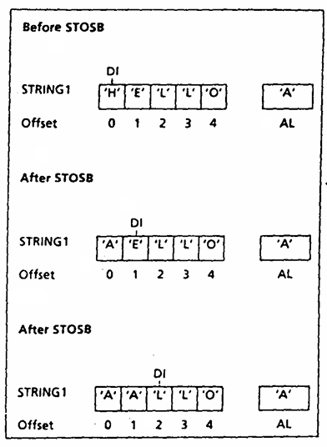
STOSB

Slide 11
LODSB

Slide 12
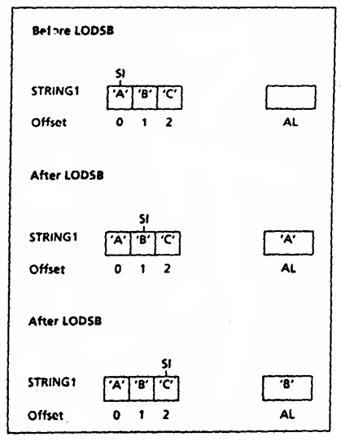
LODSB

Slide 13


SCASB

Slide 14
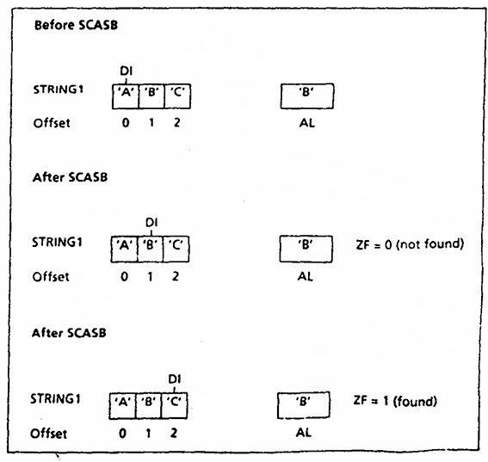
SCASB

Slide 15
CMPSB

Slide 16
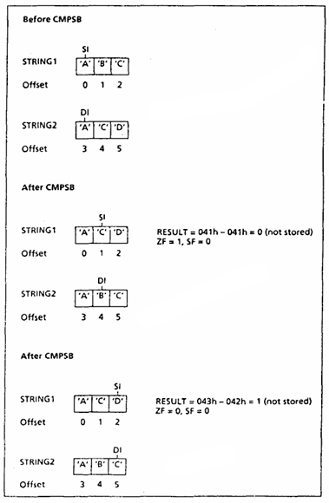
CMPSB
Figure 11.5

